Slide 1
GMO regulation in New Zealand
Dr Manda Safavi
Advisor New Organisms,
EPA, New Zealand

Slide 2



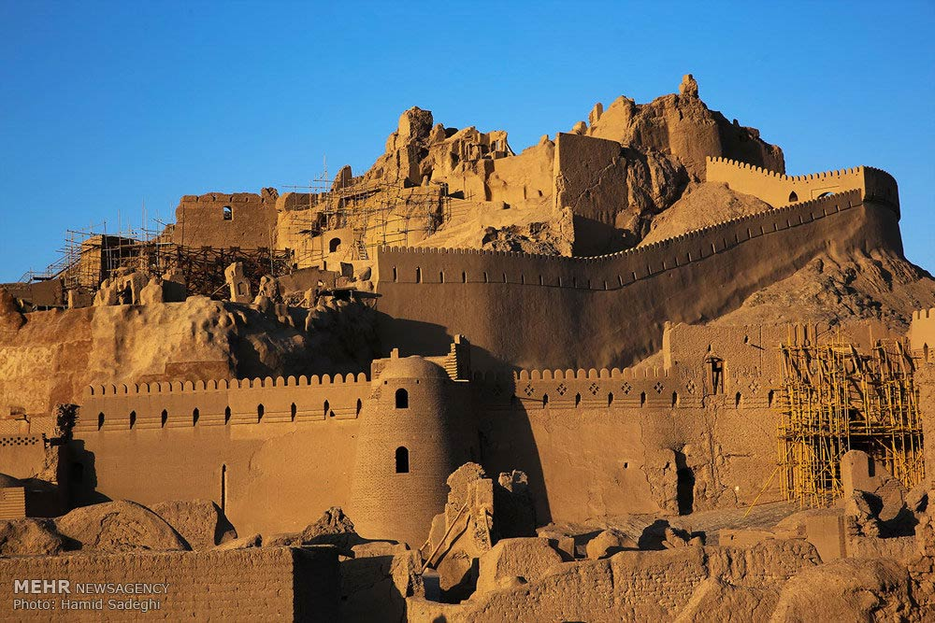



Slide 3

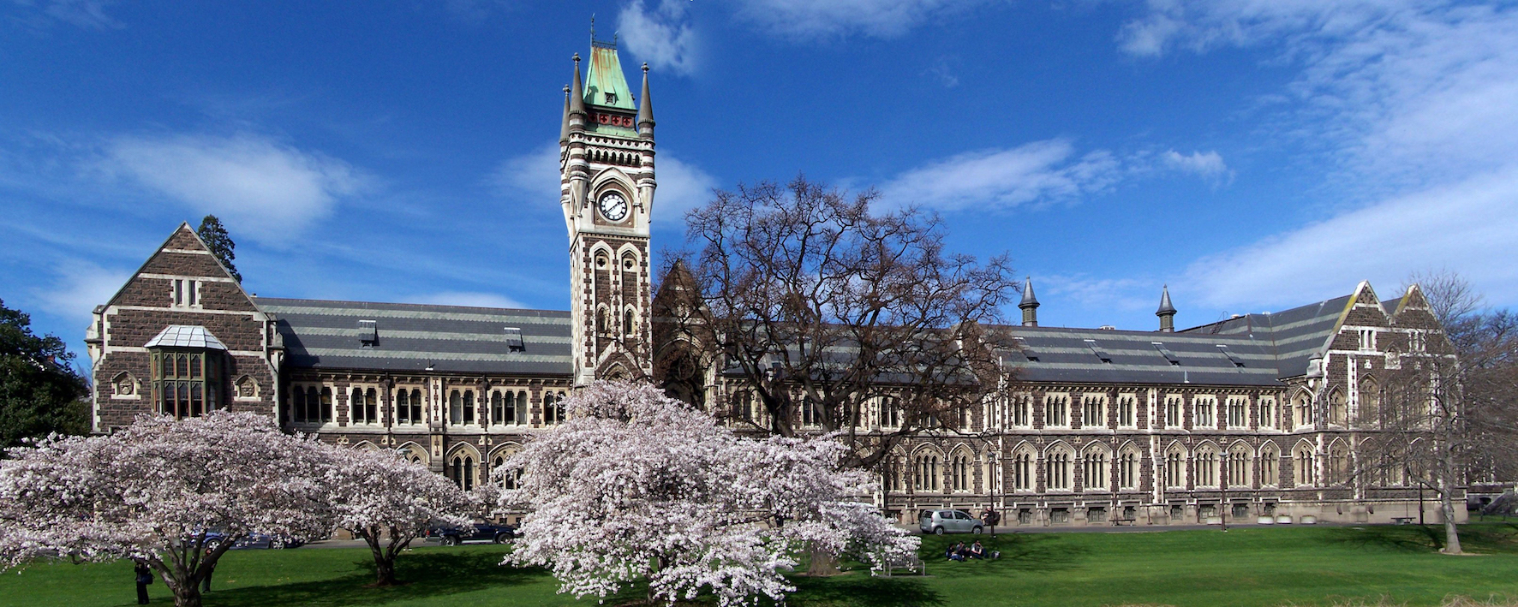

Slide 4
At the EPA, we protect the environment for a better way of life:
Exclusive Economic Zone (EEZ)
Nationally Significant Proposal (NSP) Applications
Emissions Trading Scheme (ETS) Operations
Hazardous Substances
New Organisms
Notes:
Climate, Land and Ocean

Slide 5
New organism?
A new organism is
An organisms belonging to a species that was not present in New Zealand immediately before 29 July 1998
Genetically Modified Organisms (GMOs)
GMOs
Have been modified by in vitro techniques, or
Are inherited or otherwise derived, through any number of replications, from any genes or other genetic material which has been modified by in vitro techniques

Slide 6
Who needs approval from us
Import a new organisms (incl. GMO)
Develop a new organisms (incl. GMO)
Filed trail a new organisms (incl. GMO)
Release a new organisms (incl. GMO)

Slide 7

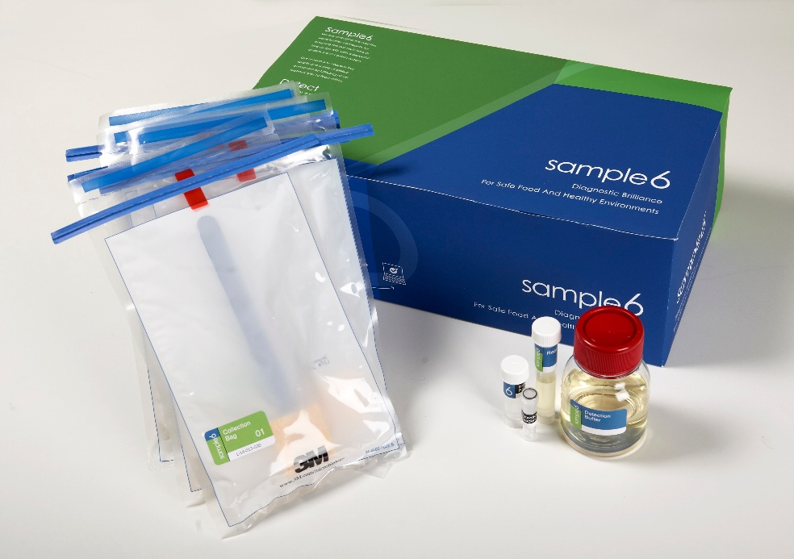
Import GMOs into containment
Figure taken from www.sample6.com
Notes:
Containment: secure an organism to a location to prevent its escape

Slide 8
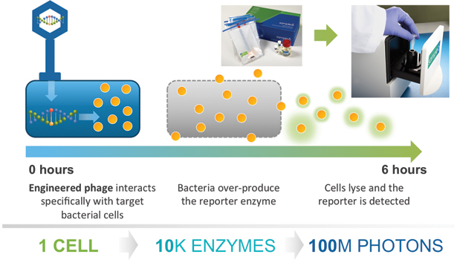
What is Sample6?
Figure taken from www.sample6.com

Slide 9



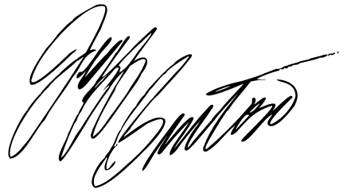





Import a GMO
30 w d
30 w d
Public health
Society/community values
Maori and their culture and traditions
Environment
Economy

Slide 10
Develop (In relation to organisms other than incidentally imported new organisms) means:
Genetic modification of an organism
Regeneration of a new organism from biological material of the organism that cannot, without human intervention, be used to produce the organism
Fermentation of a micro-organism that is a new organism

Slide 11















Develop a GMO
Full-assessment
rapid
30 w d
30 w d
10 w d
Non low-risk
2 * 30 working days
HSNO Committee
Outcome-based controls
Low-risk
10 working days
CE
Prescriptive controls

Slide 12
GMO field test
GM pine trees:
To field test in containment pine trees with genetic modifications to alter plant growth/biomass acquisition, reproductive development, herbicide tolerance, utilisable biomass, wood density and dimensional stability
GM cattle:
To field test genetically modified cattle with extra bovine genes, the insertion of the human myelin basic protein gene, and the deletion of the bovine β-lactoglobulin gene. Genes will be expressed in the milk of the cattle.

Slide 13







NKTT
Te Herenga
Facilitates Iwi consultation
Public hearing
GMO field trial
Comprehensive report
Public health
Society/community values
Maori and their culture and traditions
Environment
Economy
Statutory obligation

Slide 14
GM release
Conditional release: Pexa-Vec
Pexa-Vec: a live-attenuated vaccina virus containing three genetic modifications to be used in phase 3 clinical trial for hepatocellular carcinoma patients
Full release: none
Wild type virus
Thymidine kinase
Thymidine kinase
GM vaccina virus (Pexa-Vec)
Human hGM-CSF
LacZ
Recruits T-cells to cancer cells

Slide 15
Māori engagement
Kaupapa Kura Taiao (KKT): EPA’s Māori policy and operations group
Ngā Kaihautū Tikanga Taiao (NKTT): Māori advisory group of the EPA
Te Herenga network: EPA’s national network of Māori environmental practicioners and resource managers

Slide 16
PFNZ2050 and Gene Drive

Slide 17

