Slide 1
Genetic family tree

Slide 2
What is it?
= Family health history
Family health history represents the combined effects of genetic, environmental, and social factors that contribute to disease risk.
Family health history is a strong predictor of disease, and is an important clinical tool for identifying those at increased risk of common, complex conditions.
Knowledge of family health history has important implications for health care delivery, including screening and lifestyle recommendations targeted to early detection and disease prevention
Usually recorded as a family tree (pedigree) which allows a pictorial representation of family relationships and those family members affected by medical conditions

Slide 3
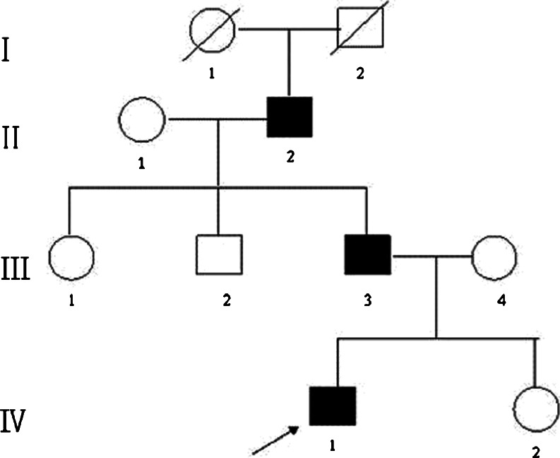
What does it look like?
Genetic family history – comprises relationships between individuals and conditions

Slide 4
Genetic information as family account
Current paradigm between individuals
“New” concept in western medicine genetic information (and how it is shared) family level
50% genetic information shared between parents and siblings (1st degree)
25% genetic information shared between aunts and uncles and nieces and nephews (2nd degree)
12.25% genetic information shared between first cousins (3rd degree)

Slide 5
What does involve
Provider asking questions – usually to three generations
Using symbols
Connect with lines to show the relationship
Standardised symbols for drawing pedigrees have been adopted internationally.
This helps to ensure that health professionals throughout the world can share, understand and interpret family history information.

Slide 6
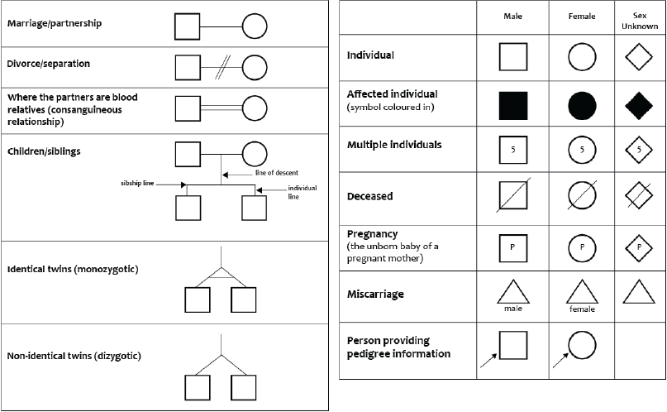
The symbols

Slide 7
How to record information about the family

Slide 8
Getting started
Start with person giving information
Top if going downwards (e.g. if patient is a grandparent)
Bottom if going upwards (e.g. if patient is a child)
Place males on the left

Slide 9
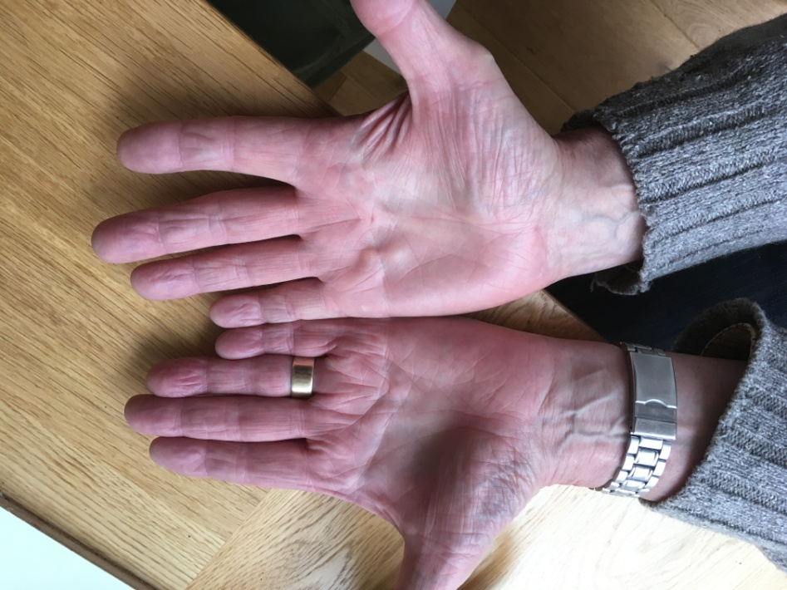
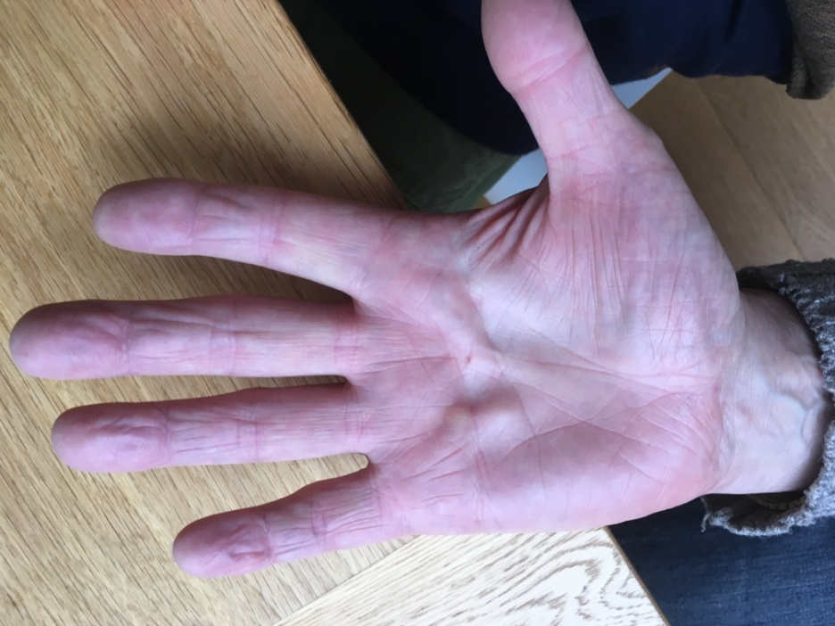
Viking’s Disease (Duputryen’s Disease)
Tradition has it that the disease originated with the Vikings
Thickening tissues in palm of hand, causes contraction

Slide 10
Pedigree
I
II
III
? inheritance
Autosomal dominant condition = 50% chance of inheriting from my father

Slide 11
Pedigree analysis of Unicorn syndrome
You are the patient (person giving the information)
Young adult onset condition, presents as a golden bone structure protruding from the skull
Autosomal dominant condition
Your paternal grandfather has the condition, his wife didn’t
Your father has the condition but his sister didn’t
Your father married Jane
You have three siblings, one brother, two sisters
One of your sisters has inherited the unicorn syndrome

