Slide 1
Introduction to Epigenetics Kirsty Danielson (University of Otago, Wellington kirsty.danielson@otago.ac.nz) Donia Macartney-Coxson (Institute of Environmental Science and Research – ESR Donia.Macartney-Coxson@esr.cri.nz)

Slide 2
If your DNA is the unique ‘song of you’,
then epigenetics provides the audio engineers
that decide how the music is played

Slide 3
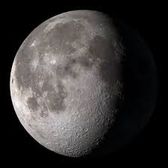
Epigenetics
“epi” means above in greek
DNA about 1.2m long in each cell,
about 32.7 trillion (32, 700,000,000,000) cells in your body!
how does it fit in?

Slide 4
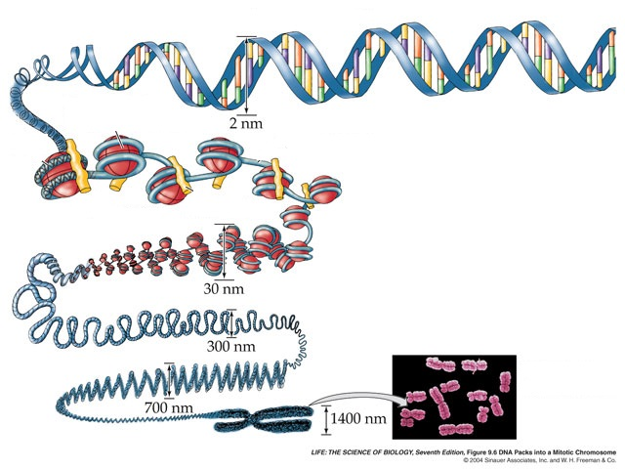

Slide 5
Epigenetics
Epigenetics wraps up the letters of DNA then what – how can the books be read?
Smart wrapping = punctuation
= !, underline, strikethrough, highlight, comma

Slide 6
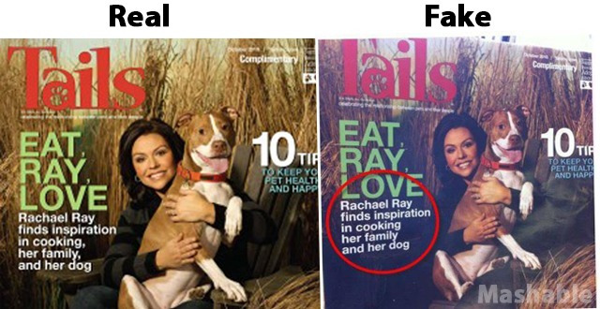

Slide 7
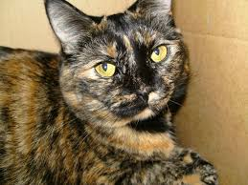
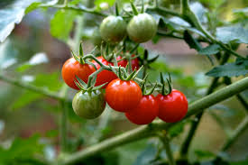
Epigenetics – you’ve seen the effects!

Slide 8
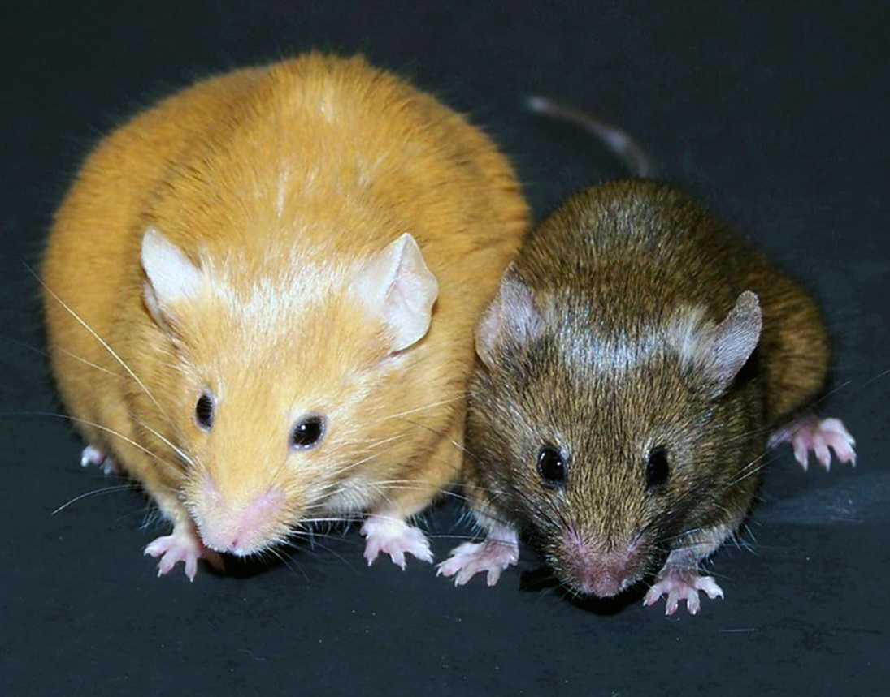

Slide 9
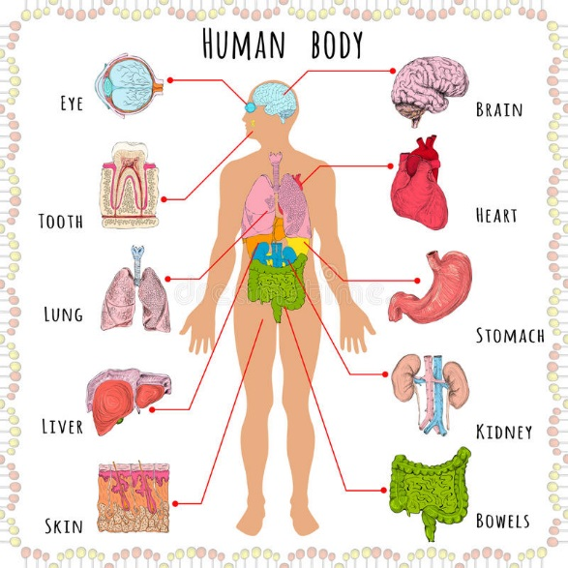
Epigenetics
Interprets the letters
which chapter of the book is relevant?
The same letters (DNA) but very different outcomes!

Slide 10
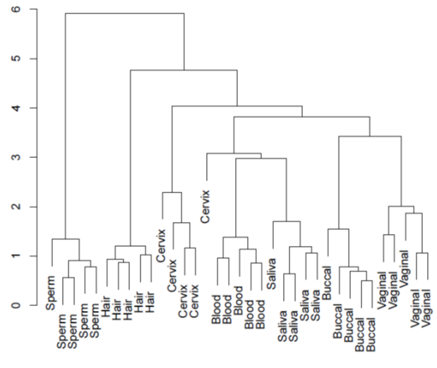

Slide 11
Epigenetics – where the language of your DNA and your environment meet

Slide 12
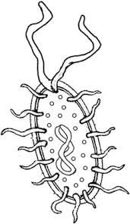
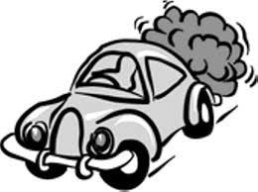
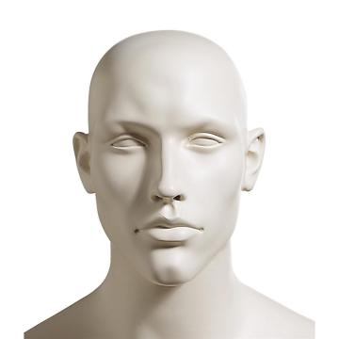
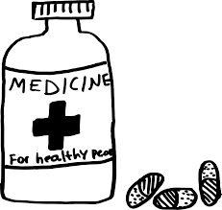
Epigenetics – where the language of your DNA and your environment meet

Slide 13
Epigenetics – a role in complex diseases, such as obesity, and type-two diabetes
Metabolic disease obesity
type-two diabetes
cardiovascular disease
+
=

Slide 14
Developmental Diseases
Obesity High Blood Pressure Type-two diabetes
Coronary Artery Disease
Bipolar Disorder
Kidney Function Autism
Inflammatory arthritis
Cancer

Slide 15
Epigenetics – where the language of your DNA and your environment meet

Slide 16
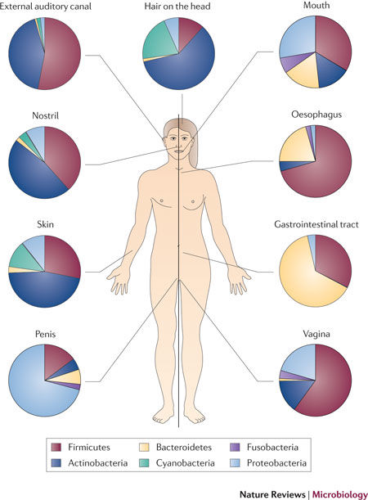
The Microbiome
Bacteria, fungi, protozoa, and viruses
10 x more microbial cells than human cells in your body (100,000,000,000 cells)
>10,000 different microbe species found in the human body so far
1-3% total body mass
Spor A, Koren O and Ley R. Unravelling the effects of the environment and host genotype on the gut microbiome. Nature Reviews Microbiology. 2011;9:279.

Slide 17
If your DNA is the unique ‘song of you’,
and epigenetics provides the audio engineers that decide how the music is played,
then the microbiome is the crowd interacting with a performance

Slide 18
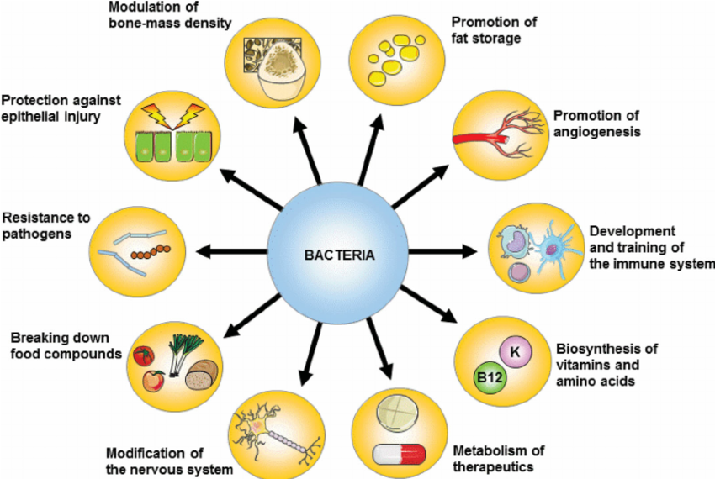
Debby Laukens, Brigitta M. Brinkman, Jeroen Raes, Martine De Vos, Peter Vandenabeele; Heterogeneity of the gut microbiome in mice: guidelines for optimizing experimental design, FEMS Microbiology Reviews, Volume 40, Issue 1, 1 January 2016, Pages 117–132,
Notes:
Vitamin K, folate etc.
Leaky guts: fixing leaky gut in animal models improves autism spectrum disorder in one model and peanut allergy in another.

Slide 19
Genetics and the microbiome
Where is there more genetic diversity between individuals: human genomes or microbiome genomes?
Are there more genes in your own genome or your microbiome genome?
Genome
e.g. horizontal gene transfer
Microbiome
Epigenome
e.g. DNA methylation differences and bacterial specific transcriptome
Notes:
Humans are 99.9% identical genetically, but individuals are 80-90% different in terms of microbiome
Genes in the microbiome outnumber genes in the human genome by 100 to 1

Slide 20
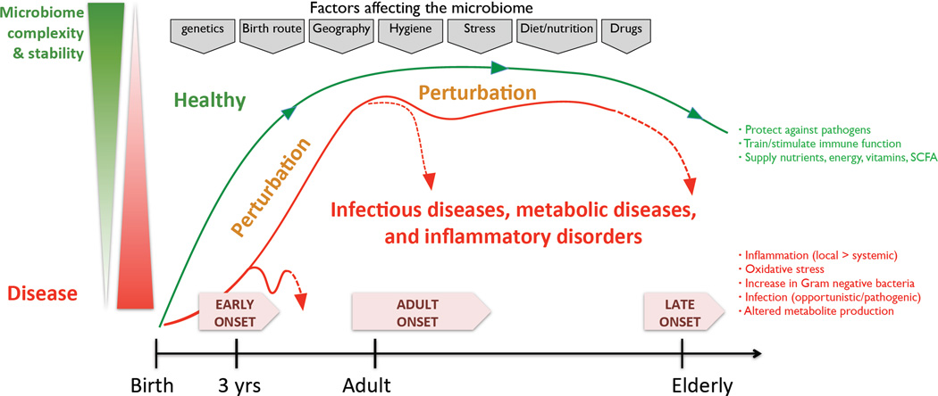
Kostic et al., Gastroenterology. 2014 May;146(6):1489-99. doi: 10.1053/j.gastro.2014.02.009. Epub 2014 Feb 19.

Slide 21
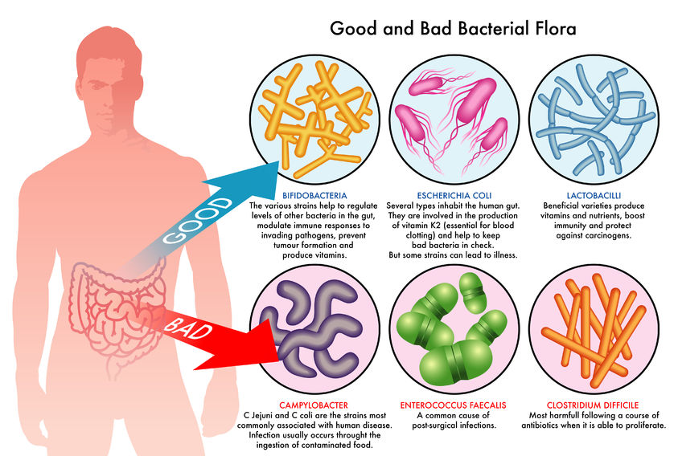

Slide 22
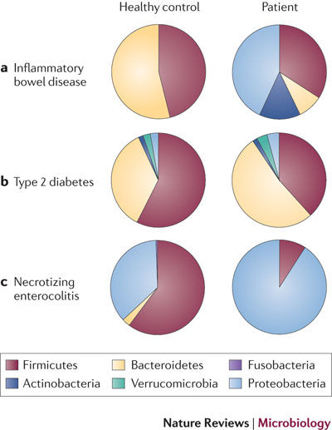
Balancing bacteria and the shift to disease
Symbiotic and usually not pathogenic (disease causing)
Individuals have >160 species of microbiota in their gut: diversity is good!
Microbiome changes with diet and travel
Spor A, Koren O and Ley R. Unravelling the effects of the environment and host genotype on the gut microbiome. Nature Reviews Microbiology. 2011;9:279.

Slide 23
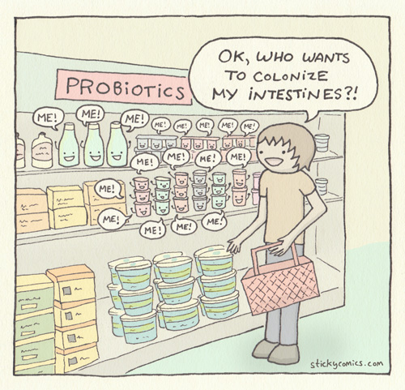
Probiotics
Probiotics are live organisms (‘good bacteria’) that can be ingested and colonise the gut to produce health benefits
Animal models show health benefits of probiotics in disorders ranging from peanut allergy to autism spectrum disorder

Slide 24
Antibiotics
“…you’re an ecosystem and what you’re doing is like spraying roundup on a grass lawn and then being surprised that broadly weeds take over and you never get the grass back again.” Professor Alan Cooper

Slide 25
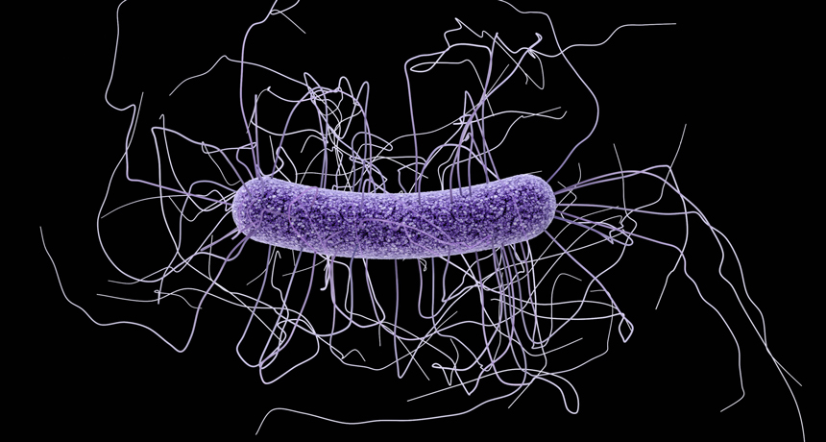
Clostridium difficile
Clostridium difficile is a spore forming bacteria that can cause colonic colitis
Often happens after a course of antibiotics
Faecal transplant to re-colonise the gut if it’s severe, 80-90% cure rate
https://www.sciencenews.org/article/genes-control-toxin-production-c-difficile-id%E2%80%99d

Slide 26
Discussion points – in no specific order!
A record of your life time environmental exposures to date?
A ‘measure’ of cultural, community, family - Ancestry AND culture?
Heritability of epigenetics: controversial, limited/temporary heritability?
Useful as biological markers (biomarkers) in medicine?
A possibly target for treatment?

